Slide 1
ASSET MANAGEMENT THROUGH QUALYS
Lets have a look at Qualys asset management capabilities

Slide 2
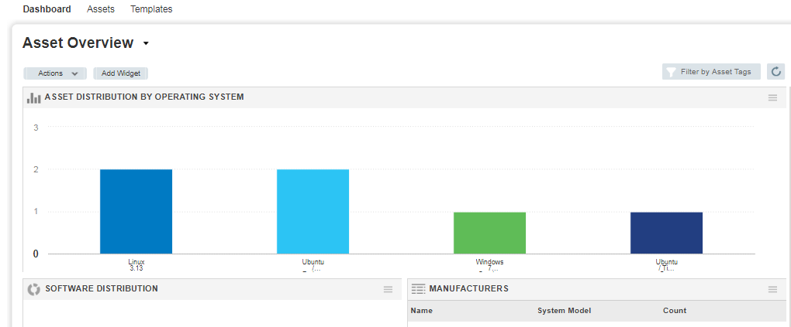
ASSET MANAGEMENT THROUGH QUALYS
QUALYS ASSET OVERVIEW DASHBOARD

Slide 3
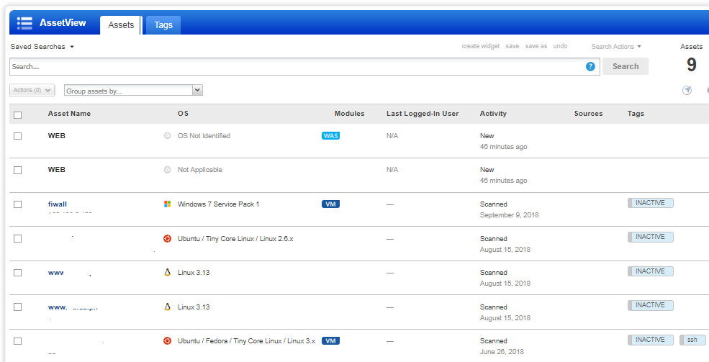
ASSET MANAGEMENT THROUGH QUALYS
QUALYS ASSET OVERVIEW DASHBOARD
ASSETS LIST

Slide 4
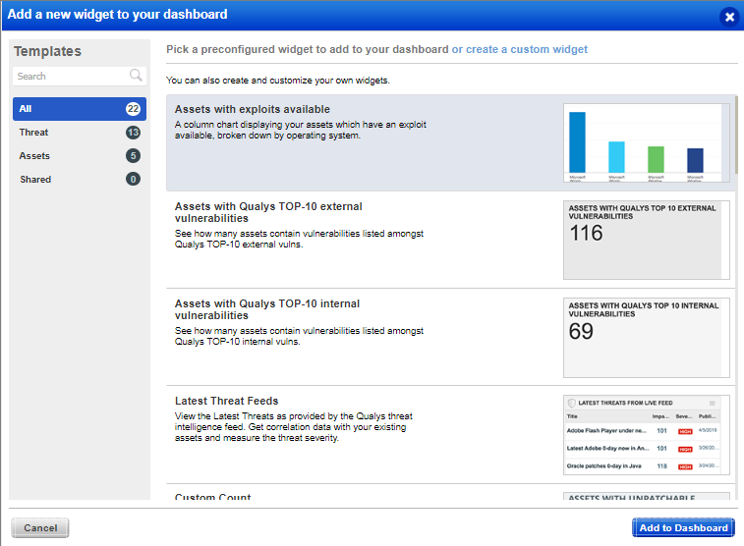
ASSET MANAGEMENT THROUGH QUALYS
ADD NEW ASSET WIDGET TO DASHBOARD

Slide 5
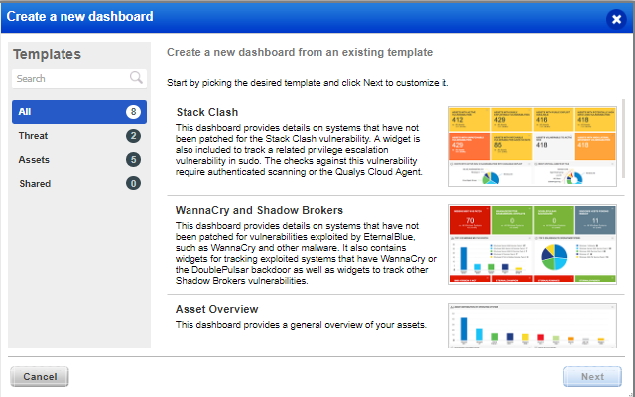
ASSET MANAGEMENT THROUGH QUALYS
CREATE A NEW DASHBOARD

Slide 6
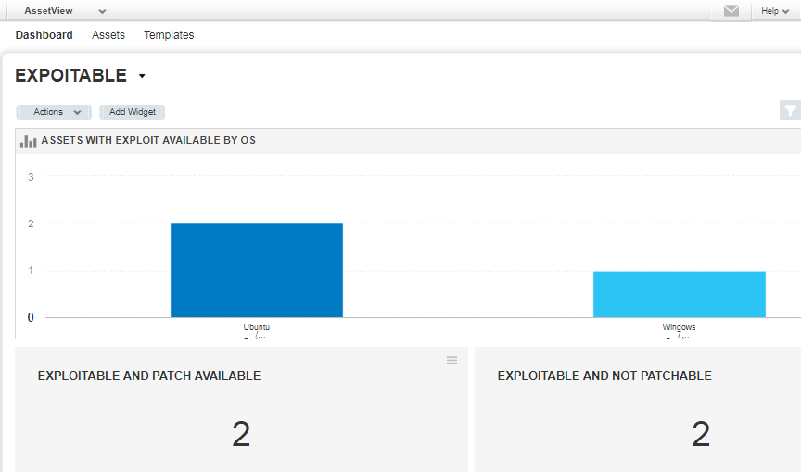
ASSET MANAGEMENT THROUGH QUALYS
NEW DASHBOARD CREATED

Slide 7
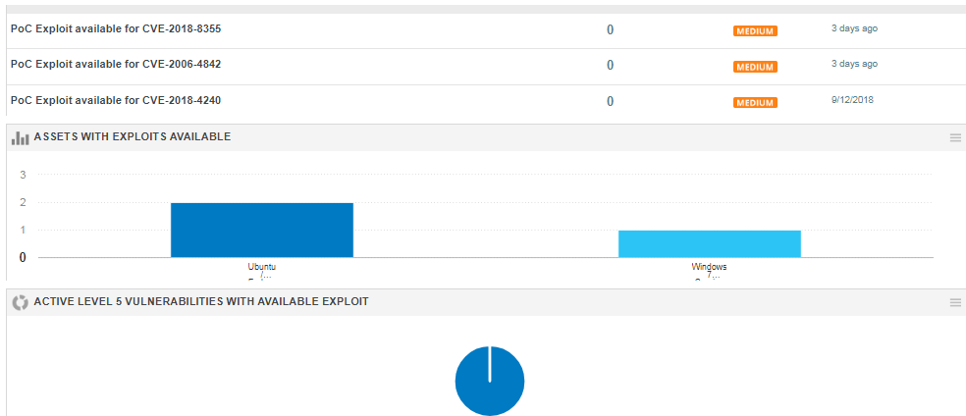
ASSET MANAGEMENT THROUGH QUALYS
ASSETS WITH EXPLOITS AVAILABLE

Slide 8
ASSET MANAGEMENT THROUGH QUALYS
Qualys allows various reporting and views on assets and their characteristics
END

